Slide 1
Text to Emotion Recognition CSE465 AZK
CSE 465:PATTERN RECOGNITION AND NEURAL NETWORK
Team Members
Md. Rifat Hasan
ID: 1620259042
Rehnuma Sharmin
ID: 1620739042
Group ID: 11

Slide 2
Text to Emotion Recognition Using GRU

Slide 3
The Problem in Focus
Emotion Detection in text documents is essentially a content based classification problem involving concepts from the domains of Natural Language Processing as well as Machine Learning.
Emotion detection aims to detect and recognize types of feelings through the expression of texts, such as anger, love, fear, sadness, joy and surprise.
Our dataset is a combination of around 420,000 tweets from kaggle.

Slide 4
Initial Approach
First we learned some basic pytorch and how to use google colab.
Then we tried to see some reference work from this filed of problem and try to understand the workflow and the desired results.
Then we tried to understand which architecture gives the optimal result.
Use started testing CNN, RNN models.
Learned some pre-possessing technique such as one hot encoding, binarization etc.

Slide 5
Training Session
Data pre-processing
We used tokenization, index word mapping, padding, binarization using one hot encoding.
Data Split & loader
We made an 80-20 split and split the validation further by 50:50. We used dataloader function to load our data and created batches to train. Each batch size=64. Also created a batch iterator.
Construct GRU model
We defined our model and added some regularization . Embedding, dropout
Testing the dimensions
we passed a sample of the dataset and making sure that the dimensions of the outputs are the expected ones.
Training Optimizer
Finally we trained our data with CrossEntropyLoss and adam optimizer with epochs size 10.

Slide 6
Results
From our evaluation of our testing data we get an accuracy of 94%. Which is highly satisfactory.

Slide 7
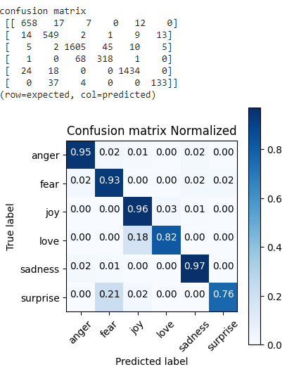
Results
We run about 210 EPOCH in the training session. But after 50th EPOCH the accuracy started to decline rapidly. At 210 EPOCH we get around 50% accuracy. So we chose the best result which was found at 10th EPOCH was 93.1%.

Slide 8
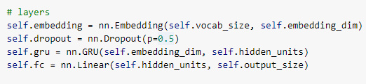

Regularization
Dropout
We used Dropout regularization in our network. Dropout works by probabilistically removing, or “dropping out,” inputs to a layer, which may be input variables in the data sample or activations from a previous layer.
Adam (Adaptive Moment Estimation)
It’s a method of Stochastic Optimization is a technique implementing adaptive learning rate

Slide 9
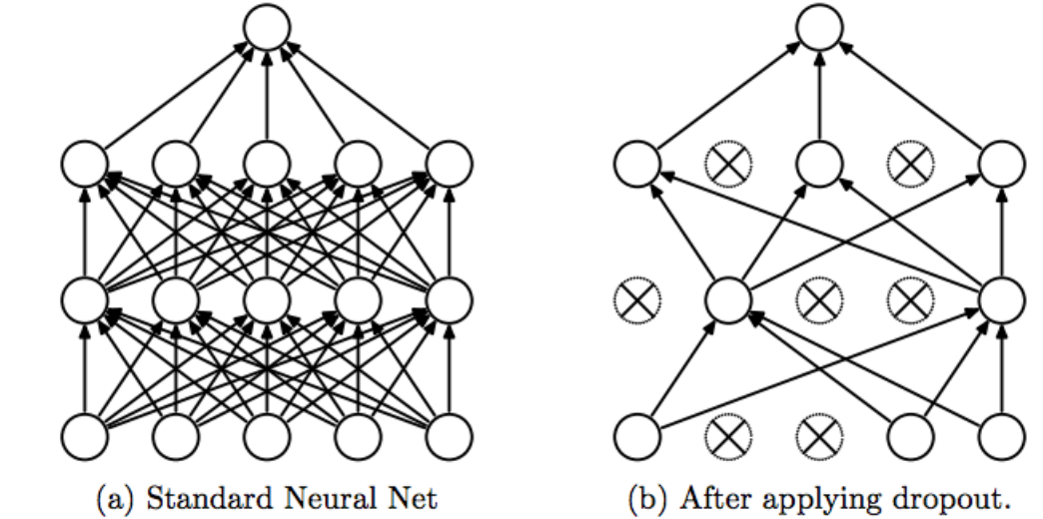
Regularization
Impact on Result
Before using dropout we had huge overfitting issues. Our training data accuracy was high but validation accuracy was really low compared to it. After tuning in our dropout the accuracy increased dramatically.
Stochastic gradient descent maintains a single learning rate for all weight updates and the learning rate does not change during training but after using Adam optimizer we could control the learning rate to our advantage. The algorithm calculates an exponential moving average of the gradient and the squared gradient, and the parameters beta1 and beta2 control the decay rates of these moving averages. We used default values recommended by the authors of Adam Beta1=.9 and Beta2=.999 [1]

Slide 10
Hyper-Parameters
Dropout
The hyper-parameter in Dropout is the p value. We tried different p values as .4, .5, .6, .7 and .5 gave us the best results in accuracy.
Adam
The hyper-parameter in Adam is ε value. Tuning epsilon doesn’t really affect our result so we used the recommended value by the authors which is 10^-8 [1]
Crosssentropyloss
We used the default values for this parameter. It expects outputs and class indices as target.

Slide 11
Done Differently?
If started from scratch
More data
Used CNN
SGD
Overfitting
I would more data into the dataset
I would like to use CNN architecture specially ResNet to see how the result varies.
Work with SGD optimization instead of Adam
I would more hyper-parameters to lessen the overfitting problem to run more EPOCH and get a more accurate result.

Slide 12
Learnings from this Project
How to work with Pytorch, Google Colab platform
Understand neural networking architecture such as CNN, RNN and many variants of these networks
Optimization and regularization of neural networks
Use of hyper-parameter to gain better results.
Different Pre-processing techniques

Slide 13
Conclusion
We trained and tested a deep neural networks, using Gated recurrent unit(GRU) (RNNs), for addressing a natural language task known as emotion recognition. We had a dataset labeled 6 categories and after training, our tested data achieved an accuracy of 94%. Which is satisfactory but I feel we can achieve more with tuning more regularization and hyper-parameters.

Slide 14
Work Load
Rifat
Rehnuma
Building the GRU model
Pre-processing data
Adding Regularization, Hyper-parameter
Splitting data for training and training data optimization
Testing data & result generation confusion matrix
Testing the GRU model & Model optimization

Slide 15
References
Adam: A Method for Stochastic Optimization by Diederik P. Kingma, Jimmy Ba: https://www.researchgate.net/publication/269935079_Adam_A_Method_for_Stochastic_Optimization [1]

Slide 16
THANK YOU

